Slide 1
Fully Decentralized Multi-agent Reinforcement Learning with Networked Agents
Kaiqing Zhang
Amazon AWS AI Labs Intern
AMLC, July 10, 2019

Slide 2
Overview
Background
Modeling
Algorithms
Theoretical Results
Simulations
Conclusions

Slide 3
Overview
Background
Modeling
Algorithms
Theoretical Results
Simulations
Conclusions

Slide 4
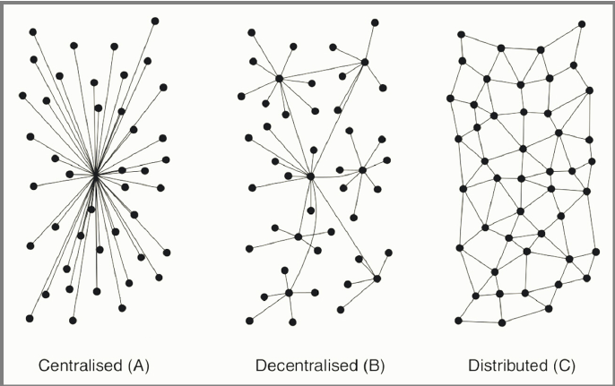
Decentralized Multi-agent Systems
Multi-agent systems (MAS) are ubiquitous
Centralized protocol v.s. Decentralized protocol
Central controller may not exists in many MAS applications
Advantages: i) resilient to attacks; ii) scalable; iii) privacy-preserving
Robotics
Smart Grid
Unmanned Aerial Vehicles
MOBA Video Games
Notes:
Robotics: Motion planning or navigation /territory exploration; robocup
The benefit of decentralized: 1. may not exist central controller; 2.resillient to malicious attacks; 3. increase the scalability when adding new agents; 4. preserve the privacy.

Slide 5
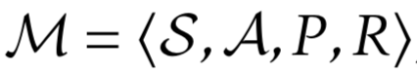
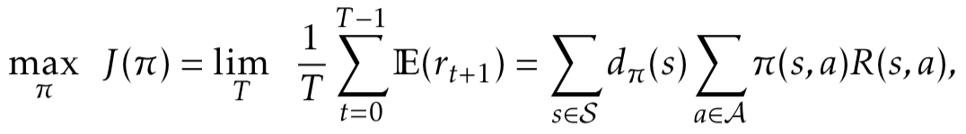
Reinforcement Learning (RL)
Markov decision process (MDP):
Goal: maximize time-average reward
Actor-critic algorithm
 | Pros. | Cons.
Value-based | Easy to implement | Can diverge with function approx.; can hardly handle continuous actions
Policy-based | Allow continuous action and stochastic policy; conv. guarantee with FA | Large variance of gradient estimate
Source: Reinforcement learning Lecture Notes, David Silver, 2016

Slide 6
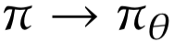
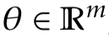
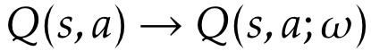
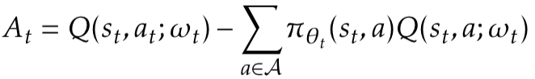
Actor-critic Algorithm
Parametrized policy with parameter
Basis: Policy Gradient Theorem [Sutton et. al. ’00]
Critic: policy evaluation with function approximation
Actor: policy improvement following gradient direction
Actor-critic + NN achieves state-of-the-art result in MARL [Lowe et al., ’17]
baseline
Average running reward
Temporal difference (TD) error
TD update
Advantage function
Policy gradient update
Notes:
Stress the two-time scale and the empirical success in current works

Slide 7
Overview
Background
Modeling
Algorithms
Theoretical Results
Simulations
Conclusions

Slide 8
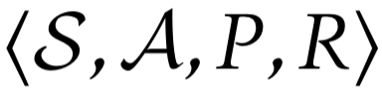
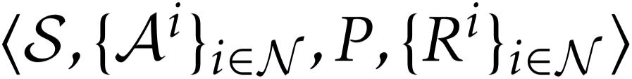
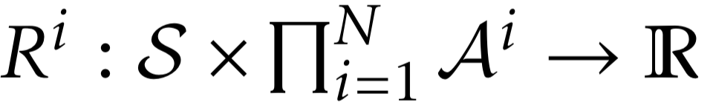
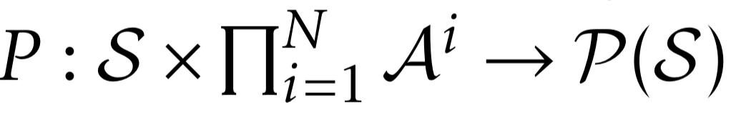
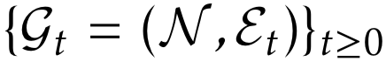
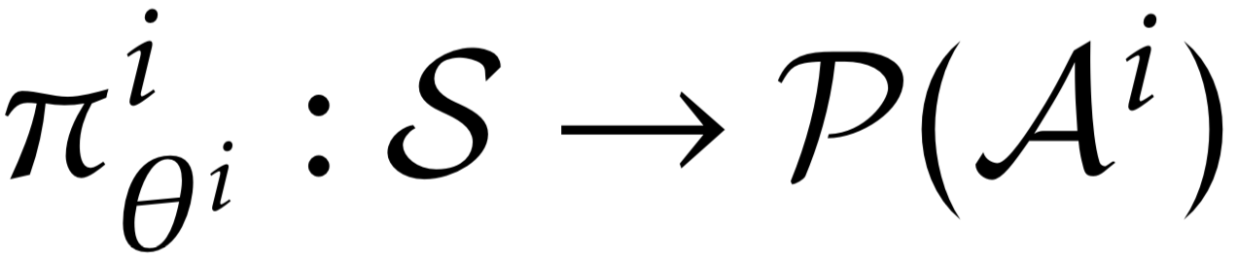
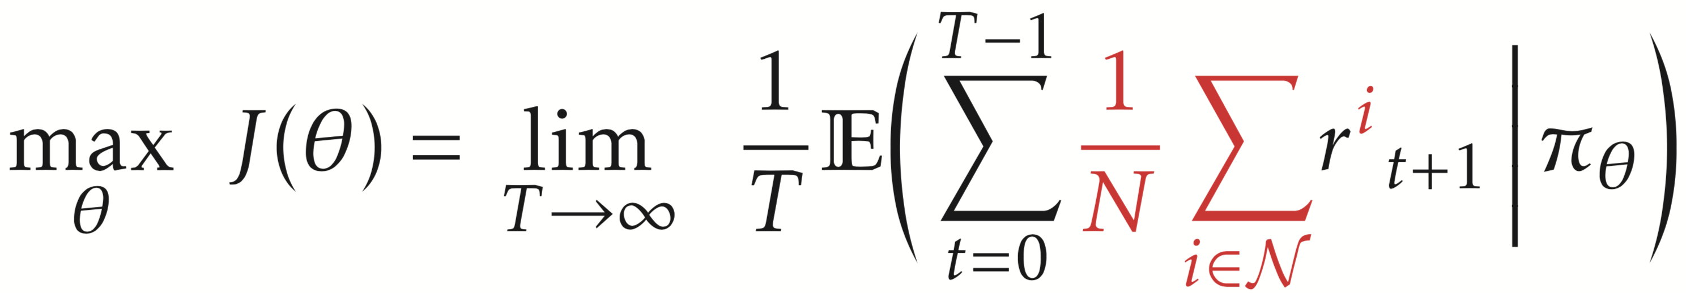
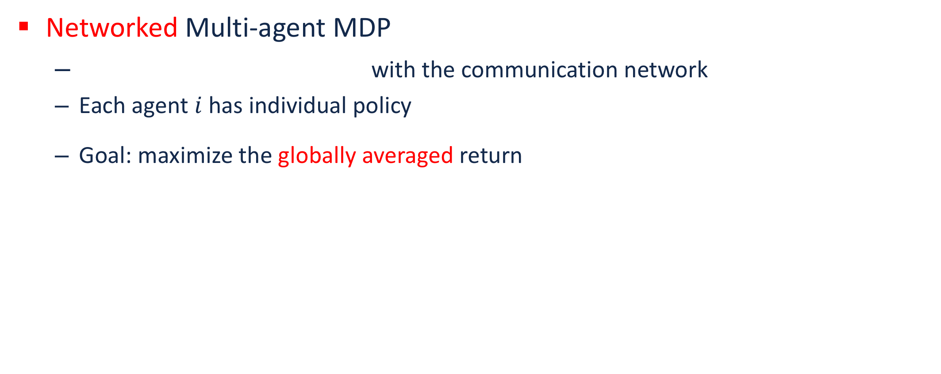
Collaborative Multi-agent RL
Multiple agents operate in a common environment
Our focus: fully decentralized setting
No central controller exists to coordinate
A fully decentralized network with heterogeneous agents
Both information and control are local
Networked Multi-agent MDP
with the communication network
Each agent $i$ has individual policy
Goal: maximize the globally averaged return

Slide 9
Related Work (Selected)
Multi-agent MDP [Boutilier ’02] and team Markov games [Wang et al., ’03][Arslan et al, 17’]: common reward function
Deep MARL [Lowe et al., ’17][Foerster et al. ’17][Gupta et al., ’17]: centralized critic or common reward
Multi-task RL [Wilson et al., ’07][Teh et al., ’17]: related but independent MDPs
A3C [Mnih et. al, ’16] and parallel computation/concurrent learning in RL: independent copies of one MDP
Most relevant: QD-Learning [Kar and Poor, ’13], however
Need a remote/global controller for action execution
Only consider the tabular setting with Q-learning
Notes:
In the multi-task examples, for the second one, they also have multiple workers, but they are in face of different but relevant MDPs, which are independent of each other

Slide 10
Overview
Background
Modeling
Algorithms
Theoretical Results
Simulations
Conclusions

Slide 11
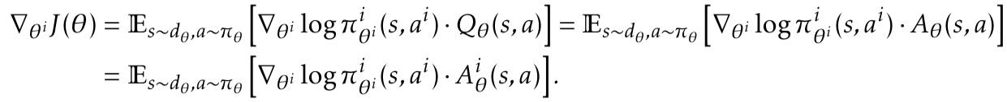
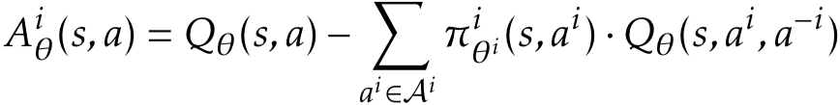
Algorithms
Multi-agent actor-critic algorithms
Fully decentralized update (only local information exchange allowed)
Using function approximation
Ideally, having theoretical convergence guarantees
Policy Gradient Theorem for MARL
where
For local policy improvement, a consensual estimate of global Q/advantage function is needed
Counterfactual baseline [Foerster et al., ’18][Wu et al., ’18]

Slide 12
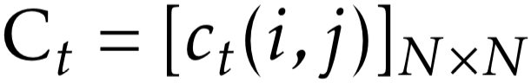
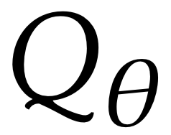
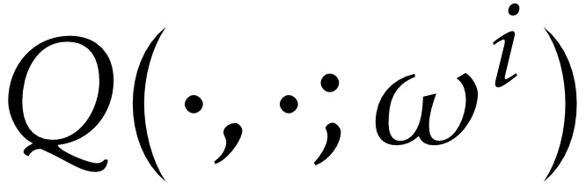
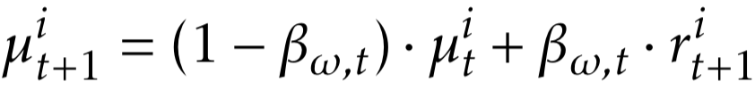
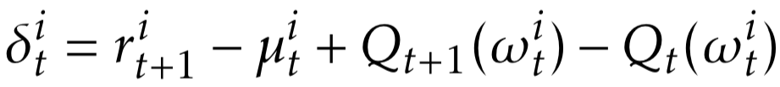
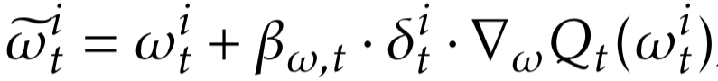
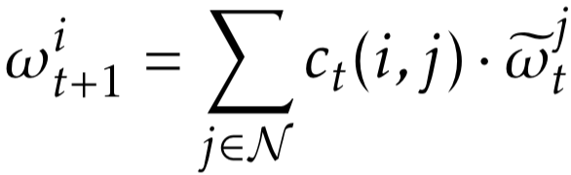
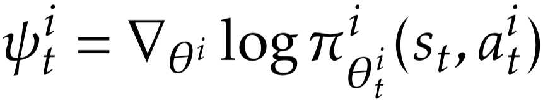
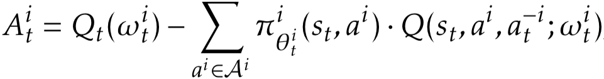
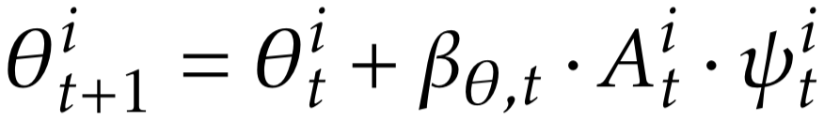
Algorithms
Consensus-based critic step:
Algorithm 1: Q function-based
Critic-step:
Actor-step:
weight
Local TD update
Consensus update
Estimated advantage function
Local policy gradient

Slide 13
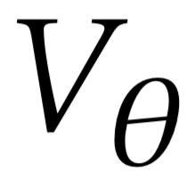
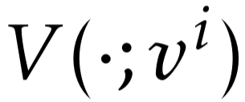
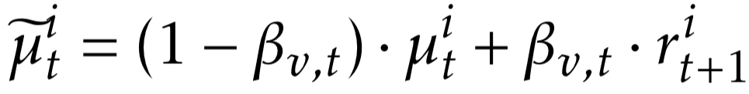
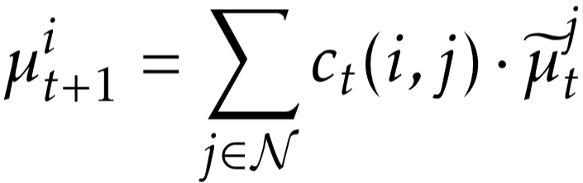
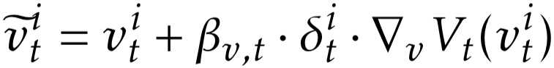
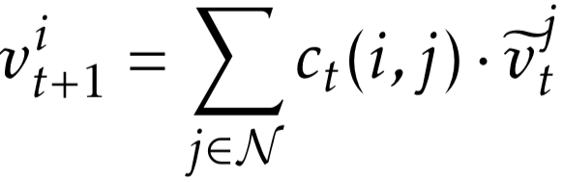
Algorithms
TD error unbiasedly estimates the advantage function
Algorithm 2: Value function-based
Critic-step:
Local TD update
Consensus update

Slide 14
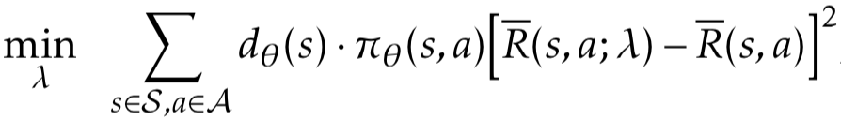
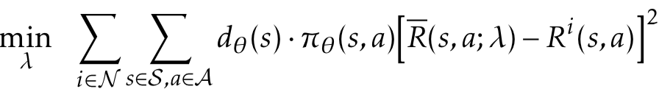
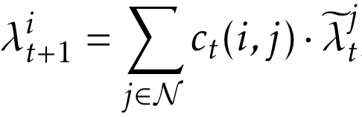
Algorithms
TD error unbiasedly estimates the advantage function
Algorithm 2: Value function-based
Need to estimate by
Critic-step (cont’d):
Globally averaged reward
Separable objective

Slide 15
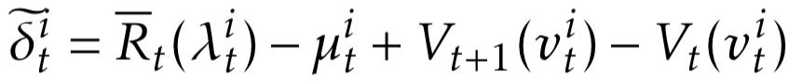
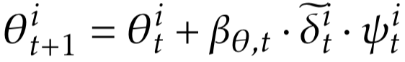
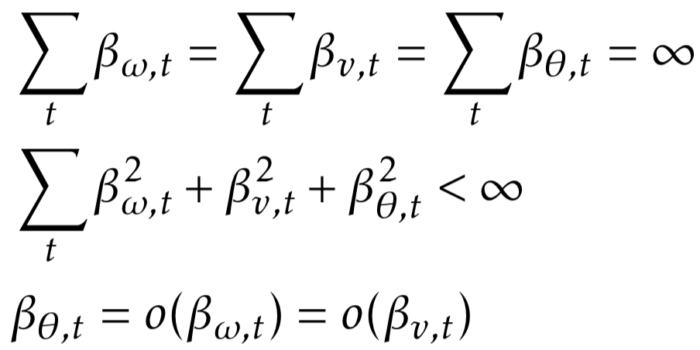
Algorithms
Algorithm 2: Value function-based
Actor-step:
Two time-scales:
Estimated globally averaged reward
Local policy gradient

Slide 16
Overview
Background
Modeling
Algorithms
Theoretical Results
Simulations
Conclusions

Slide 17
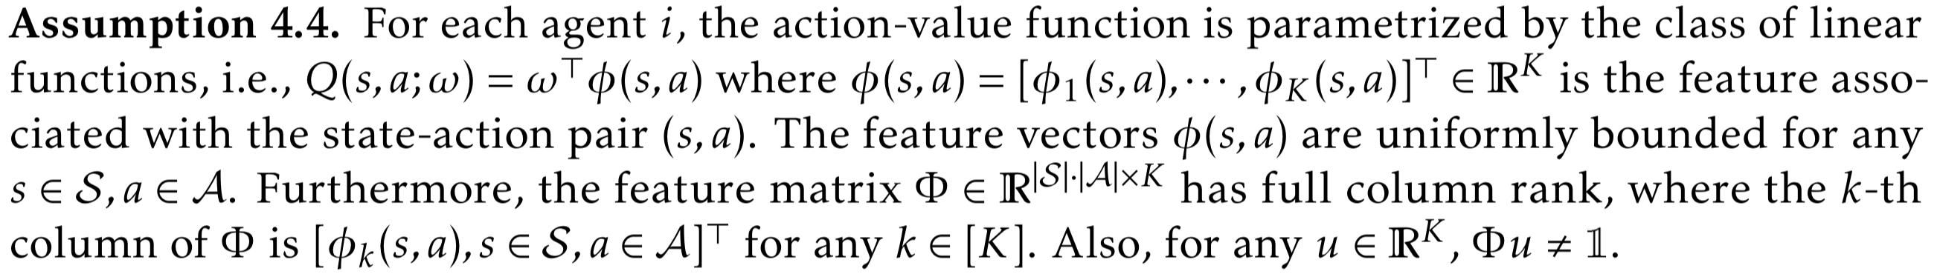
Assumptions
Regularity conditions for MDP [Bhatnagar et al. ’09]
Policy parameter set [Bhatnagar et al. ’09]
Linear function approximation [Tsitsiklis & Van Roy, ’99]

Slide 18
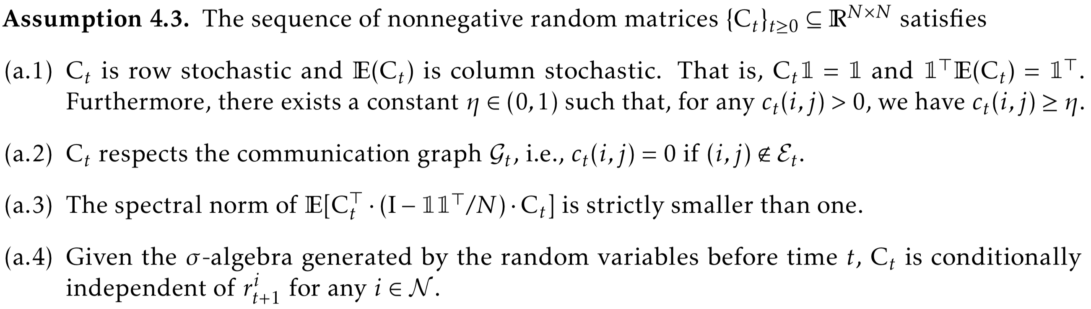
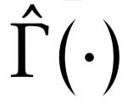
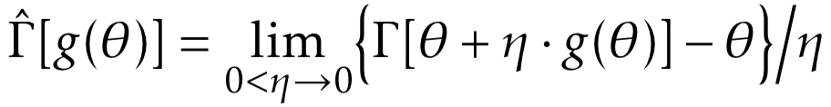
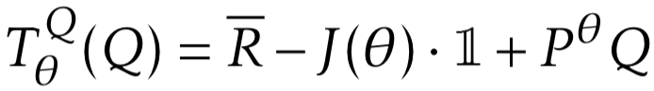
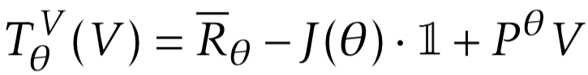
Assumptions
Consensus weight
Define projected-gradient operator :
Bellman operators:

Slide 19
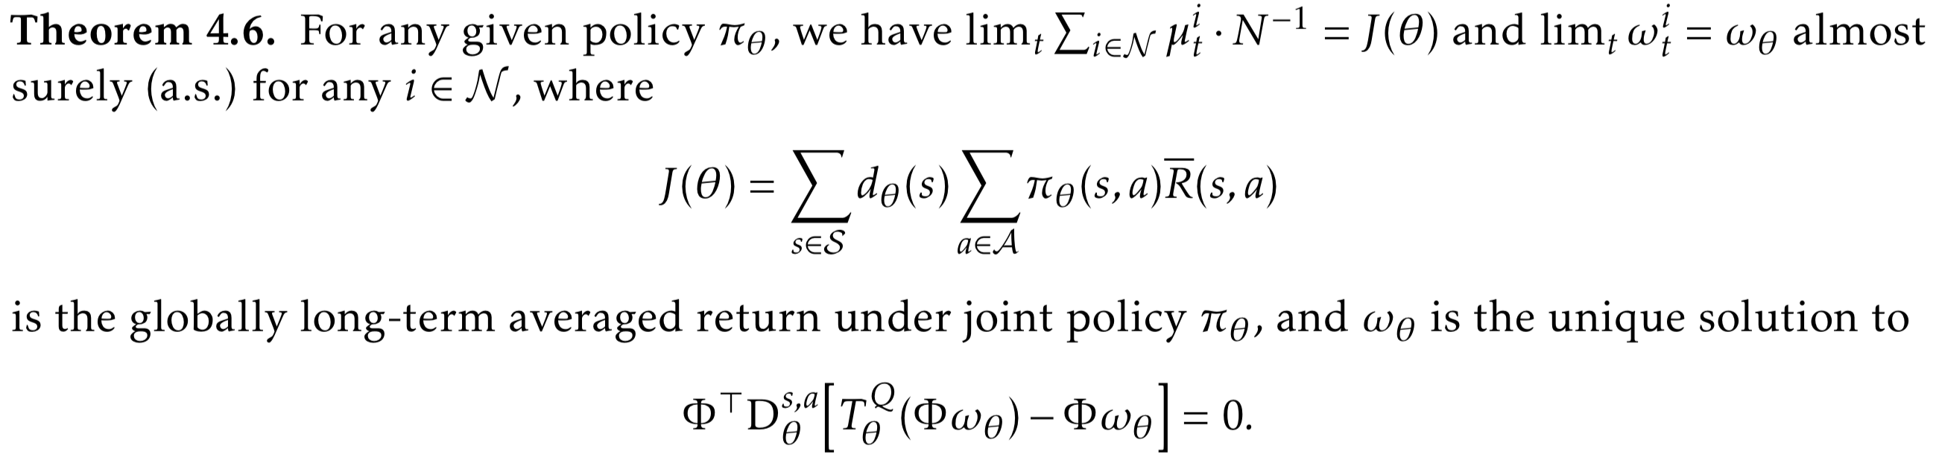
Convergence Results
Algorithm 1
Critic-step
The same fixed-point that single-agent critic step converges to

Slide 20
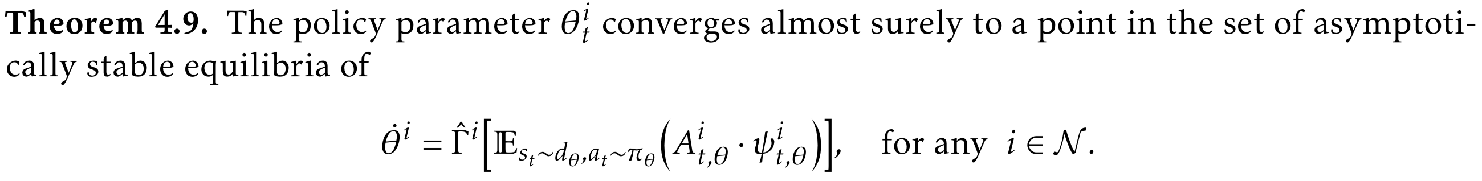
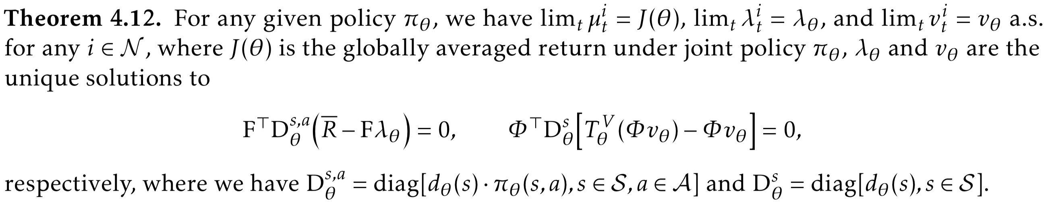
Convergence Results
Algorithm 1
Actor-step
Algorithm 2
Critic-step
The best convergence result can hope for even for single-agent actor-critic

Slide 21
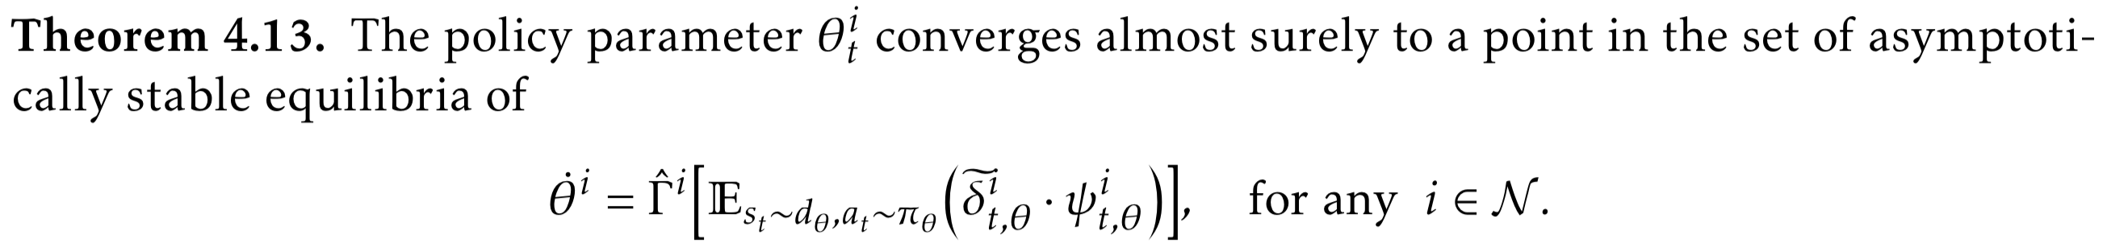
Convergence Results
Algorithm 2
Actor-step

Slide 22
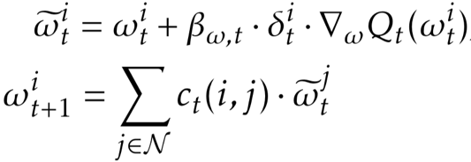
Technical Remarks
Basic technique: two-timescale stochastic approximation [Borkar, ’08]
Critic-step: most existing proof techniques on distributed/consensus optimization do not apply
TD update is not a stochastic gradient
of a fixed and well-defined function
Noises are correlated in online RL algorithms
As a byproduct, we have also proved the stability, i.e., almost sure boundedness, of this consensus stochastic sequence
The same type of convergence guarantees as single-agent actor-critic

Slide 23
Overview
Background
Modeling
Algorithms
Theoretical Results
Simulations
Conclusions

Slide 24









Linear Function Approximation
Randomly generated MDP + linear function approximation
, , ,
Local policy
is the normalized absolute Laplacian
matrix of random graph
Fig. Convergence of value functions
Fig. Convergence of globally averaged returns
Fig. Policies the algorithms converge to

Slide 25


Nonlinear Function Approximation
MARL task: Cooperative navigation problem [Lowe et al., ’17]
Each agent covers a different target landmark
Reward: vicinity to the target landmark + collision avoidance
Using 3-layer neural nets for function approximation of both actor and critic
Fig. cooperative navigation problem
Fig. Comparison between the decentralized algorithms and their centralized counterparts
Fig. Comparison between the cooperative algorithms (centralized & decentralized) and the non-cooperative ones

Slide 26
Overview
Background
Modeling
Algorithms
Theoretical Results
Simulations
Conclusions

Slide 27
Conclusions
We proposed a fully decentralized multi-agent reinforcement learning model with networked agents
We developed the first decentralized online actor-critic algorithms with function approximation, which only rely on neighbor-to-neighbor communications
We proved the convergence of the algorithms with linear function approximation, and corroborated the results via simulations
Future work
The mixed setting with both collaborative and competitive agents over the network
Improve the convergence guarantee for (MARL) actor-critic algorithms
Finite-sample analyses for MARL

Slide 28


Acknowledgement
Zhuoran Yang (Ph.D. Candidate, Princeton)
Prof. Tamer Başar (UIUC)
Prof. Han Liu (Northwestern Univ.)
Prof. Tong Zhang (HKUST)
Funding: US Army Research Office (ARO) Grant W911NF-16-1-0485,
US Army Research Laboratory (ARL) Cooperative Agreement W911NF-17-2-0196
NSF CAREER Award DMS1454377, NSF IIS1408910, NSF IIS1332109.

Slide 29
Thank You!

